Slide 1

Chapter 1: Overview of Artificial Intelligence
"General Knowledge of Artificial Intelligence" High School Edition

Slide 2
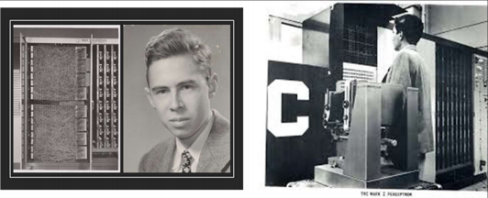
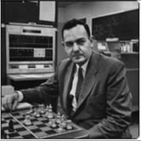
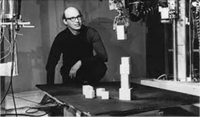
Section 7: History of Artificial Intelligence Development (1)
"General Knowledge of Artificial Intelligence" Junior High Edition
Producers: Yang Lan / Qinhan School

Slide 3
Learning Objectives
Understand the four early stages of AI development (the Golden Decade, the AI Winter, the Brief Thaw, and the Second Lull). Master the core progress of symbolic methods (theorem proving, expert systems) and neural networks (perceptrons, backpropagation). Understand the causes of the two lulls and the historical lessons learned.

Slide 4
Table of Contents
I. The Golden Decade (1956-1974)
II. The Arrival of the AI Winter (1974-1980)
III. The Brief Thaw (1980-1987)
IV. The Second Lull (1987-1993)
V. Summary

Slide 5

Scenario Creation
If AI technology development suffers a major setback, how should scientists respond? Have similar events occurred in history?

Slide 6
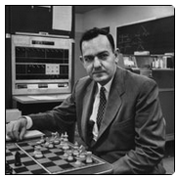
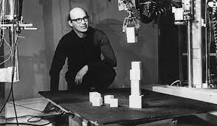
The Golden Decade (1956-1974)
The decade following the Dartmouth Conference is known as the "Golden Decade" of artificial intelligence, marking the first peak in the history of AI development. During this period, researchers made a series of exciting advances in theorem proving, conversational robots, and neural networks. These achievements led people to believe that creating machines with human-level intelligence was not a difficult task.
“Within twenty years, machines will be capable of doing any work a man can do.” — Herbert Simon, 1956.
“In from three to eight years we will have a machine with the general intelligence of an average human being.” — Marvin Minsky, 1970.

Slide 7
The Golden Decade (1956-1974)
During this decade, a large amount of funding was invested in AI research, and many famous universities established artificial intelligence research institutions, including MIT where Marvin Minsky was, Carnegie Mellon University where Allen Newell and Herbert Simon were, the AI laboratory created by John McCarthy at Stanford University, and the AI laboratory created by Donald Michie at the University of Edinburgh in the UK.
Theorem proving, conversational robots, and neural networks are three representative achievements.

Slide 8
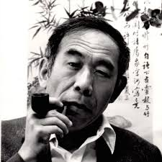
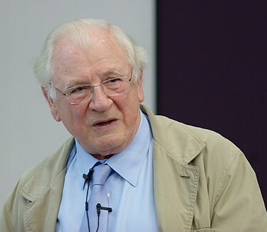
The Golden Decade (1956-1974)
In 1959, Hao Wang proposed an efficient algorithm that proved all the theorems in "Principia Mathematica" in 9 minutes.
In 1965, Robinson proposed the resolution method, further expanding the applicable scope of theorem proving.
Theorem proving became the first major achievement of artificial intelligence researchers.
Hao Wang (1921-1995), a Chinese-American mathematician, professor at Harvard University, and professor at Rockefeller University. In 1983, he was awarded the first "Milestone Prize in Automated Theorem Proving" by the International Joint Conferences on Artificial Intelligence in recognition of his pioneering contributions to the field of automated theorem proving research.
John Alan Robinson (1930-2016), an American philosopher, mathematician, and computer scientist, made significant contributions to the field of theorem proving.

Slide 9
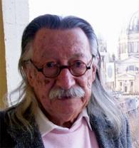
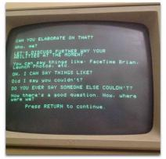
The Golden Decade (1956-1974)
ELIZA: The Template-based Robot
In 1966, Joseph Weizenbaum at MIT developed a robot program named ELIZA. This program, through a script called DOCTOR, could converse with humans in a manner similar to a psychologist.
ELIZA's working principle is based on "transformation rules," which are applied when the program detects certain keywords in the text.
Weizenbaum explained in detail how ELIZA worked, showing that the program did not truly understand human language but was cleverly programmed to appear as if it did.

Slide 10

The Golden Decade (1956-1974)
ELIZA: Can you be more specific?
Human: Who, me?
ELIZA: Let's discuss why you are available at this time?
Human: You can say things like: FaceTime Brian, Launch photos.
ELIZA: Can I say that?
Human: Did I say you couldn't?
ELIZA: Did you really say other people couldn't?

Slide 11
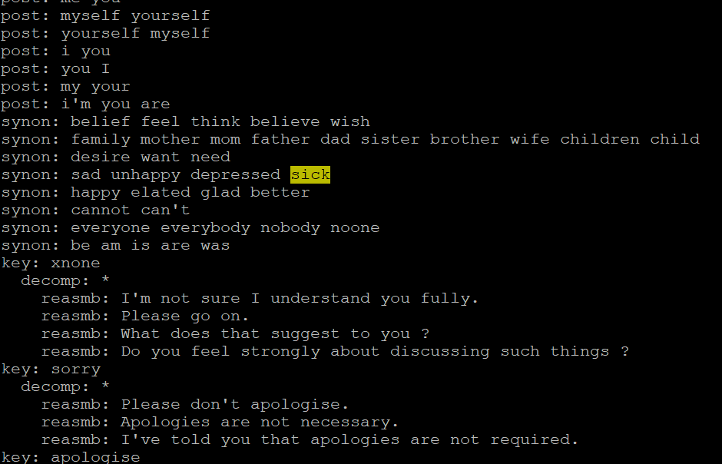
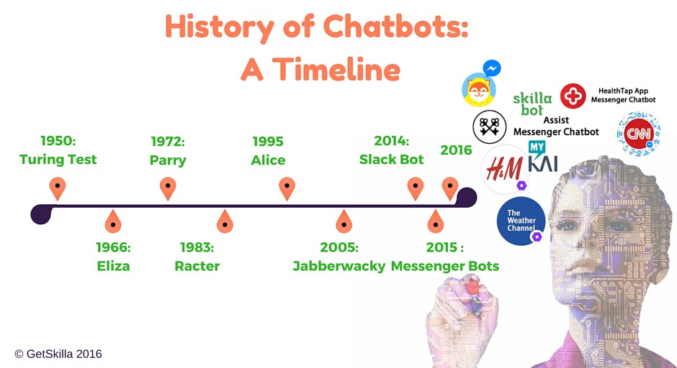
The Golden Decade (1956-1974)
Behind ELIZA were just some very simple question-and-answer templates, mainly to guide the other person to express themselves. Despite this, people still considered ELIZA to be very intelligent.
After ELIZA, conversational robots made significant progress, but human-like conversation did not emerge until the recent rise of deep learning.

Slide 12
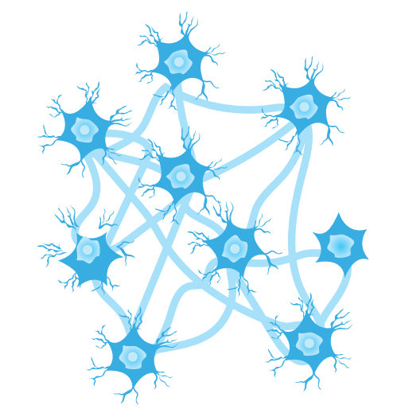
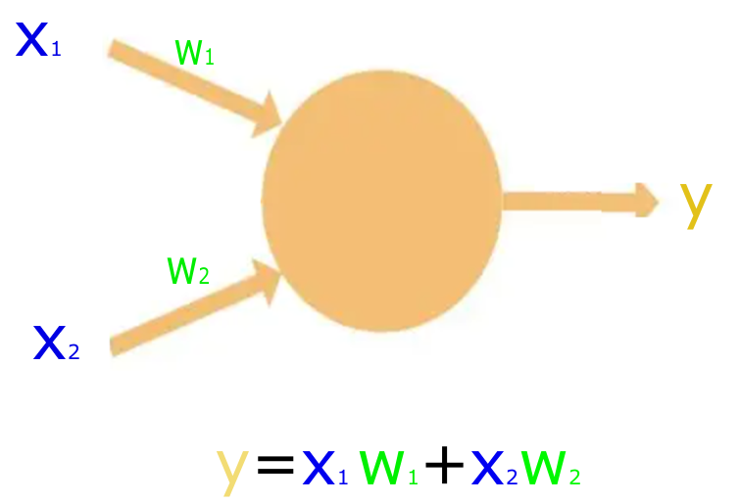
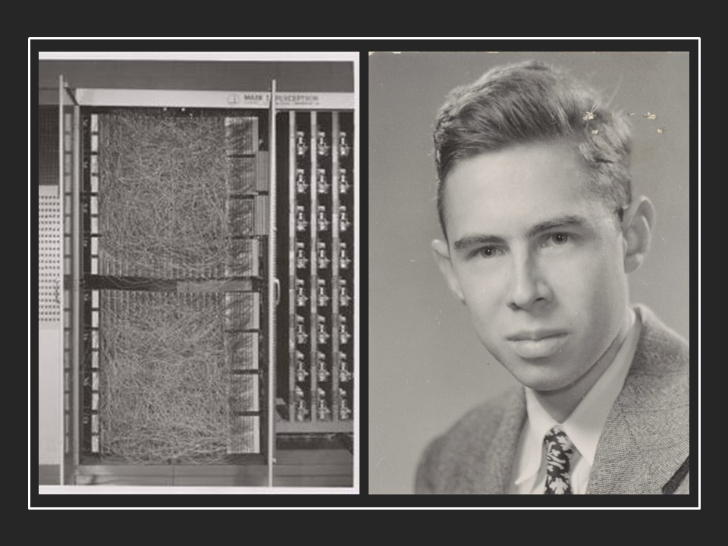
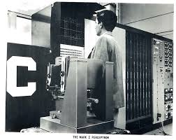
The Golden Decade (1956-1974)
Inspired by the human neural network, American computational neuroscientist Warren McCulloch and logician Walter Pitts proposed the artificial neural network (ANN) model in 1943.
In 1951, Marvin Minsky designed the first neural network computer, SNARC.
In 1958, Frank Rosenblatt of Cornell University designed a single-layer neural network called the "Perceptron," which was implemented on dedicated hardware called the Mark I, known as the Perceptron machine.
The network used the neuron structure proposed by McCulloch and Pitts, but the difference in the Perceptron model was that the connections between neurons were learnable.
Artificial neural networks simulate the human nervous system and have powerful learning capabilities.
Frank Rosenblatt (1928-1971) and the Mark I Perceptron machine.
The Perceptron machine designed by Rosenblatt took pictures as input and could recognize letters or numbers in them. The image on the right is an example of recognizing the letter 'C'.
The success of the Perceptron model was greatly encouraging, and people optimistically believed that as long as machines could learn on their own, many things could be accomplished.

Slide 13
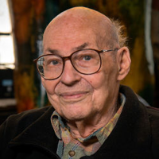
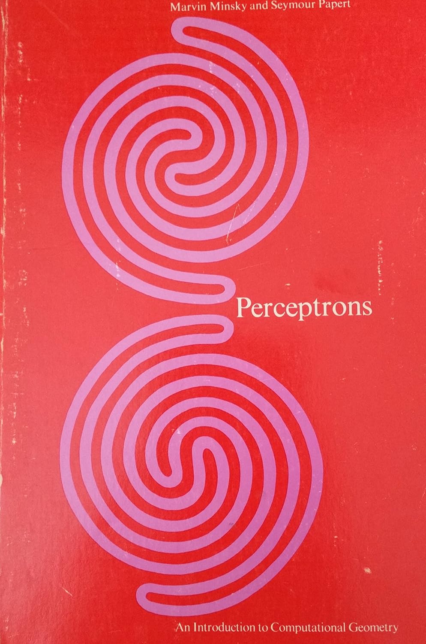
The Arrival of the AI Winter (1974-1980)
Challenges in Practical Application: The Limitations of Symbolic Systems
However, as research deepened, symbolic methods hit a bottleneck. Symbolic systems required strict definitions and struggled to describe large-scale, open-ended problems. At the same time, real-world problems involved a great deal of uncertainty that could not be fully resolved with symbolic calculus. These issues led artificial intelligence research into its first downturn.
Minsky and his book "Perceptrons," which criticized neural networks. In this book, Minsky proved that perceptrons could not handle non-linearly separable problems. This book brought neural network research to a halt.
Notes:
在《列子·汤问》中还记载了一个同时代的巧匠，名叫偃师。偃师比鲁班和墨子还要厉害，可以用木头、毛发、油漆等材料制造出惟妙惟肖的人偶，从外表看和真人无异，而且能歌善舞。偃师带着这个人偶去见周穆王，让它为大家献歌献舞。歌舞很成功，观众陶醉于其中。只是歌舞结束的时候出了差错，人偶向穆王的姬人们“暗送秋波”，惹得穆王大怒，要将偃师和这个人偶一并处死。偃师慌忙解释，并亲自动手把人偶剖开，果然是一堆零件。穆王这才相信这个人偶确实不是真人，赦免了偃师。鲁班和墨子听说这个故事后大为震撼，从此再也不敢自认为手艺高超了。这个故事当然只是个传说，2000多年前是不可能造出如此惟妙惟肖的人偶来的。尽管如此，这个故事充分体现了古人对智能机器的向往。

Slide 14
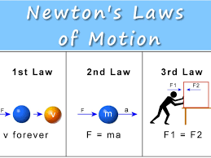

The Arrival of the AI Winter (1974-1980)
The Limitation of Perceptrons: The Constraint of Linearly Separable Problems
At the same time, neural network research had also achieved some results. However, the Perceptron model had limitations in handling non-linearly separable problems, which restricted its scope of application.
Marvin Minsky and Seymour Papert, in their book "Perceptrons," deeply analyzed the limitations of the Perceptron, pointing out that it could only solve linearly separable problems. It could not handle non-linearly separable problems, and most real-world problems are non-linearly separable.
Even if a machine knows Newton's laws, it's very difficult for it to predict whether it will rain tomorrow.
Notes:
在《列子·汤问》中还记载了一个同时代的巧匠，名叫偃师。偃师比鲁班和墨子还要厉害，可以用木头、毛发、油漆等材料制造出惟妙惟肖的人偶，从外表看和真人无异，而且能歌善舞。偃师带着这个人偶去见周穆王，让它为大家献歌献舞。歌舞很成功，观众陶醉于其中。只是歌舞结束的时候出了差错，人偶向穆王的姬人们“暗送秋波”，惹得穆王大怒，要将偃师和这个人偶一并处死。偃师慌忙解释，并亲自动手把人偶剖开，果然是一堆零件。穆王这才相信这个人偶确实不是真人，赦免了偃师。鲁班和墨子听说这个故事后大为震撼，从此再也不敢自认为手艺高超了。这个故事当然只是个传说，2000多年前是不可能造出如此惟妙惟肖的人偶来的。尽管如此，这个故事充分体现了古人对智能机器的向往。

Slide 15
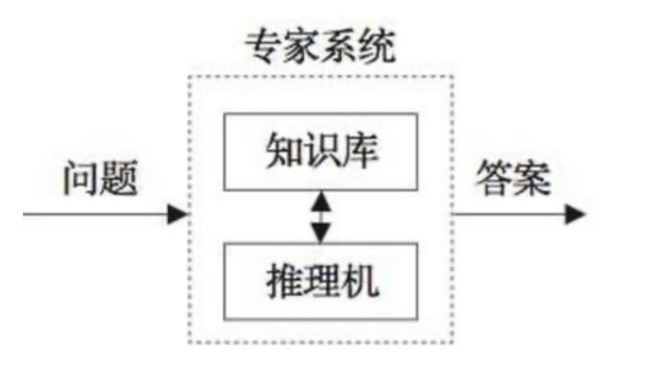
The Brief Thaw (1980-1987)
Expert Systems
Entering the 1980s, people began to realize the limitations of symbolic systems and turned their attention to specific tasks in constrained domains. Expert systems, as a type of AI based on empirical knowledge, could apply expert knowledge to solve practical problems in specific fields, becoming a new hotspot in artificial intelligence research.
Notes:
图片来自 Lewis的 “The Silent Reader”（1920）。

Slide 16
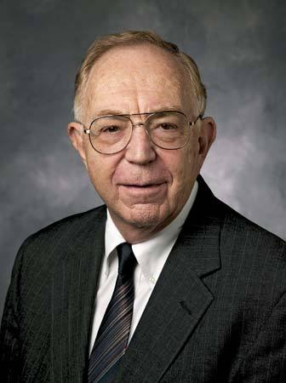
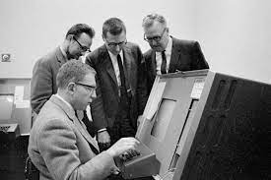
The Brief Thaw (1980-1987)
In 1965, American computer scientist Edward Feigenbaum, in collaboration with geneticist Joshua Lederberg and others, developed the world's first expert system program, DENDRAL.
DENDRAL stored the knowledge of chemists and mass spectrometers. Given the molecular formula and mass spectrum of an organic compound, it could select the correct molecular structure from thousands of possible ones. It demonstrated the potential of using expert knowledge to solve complex problems in specialized fields.
Edward Albert Feigenbaum (born January 20, 1936), a computer scientist, is known as the father of expert systems.
Received the Turing Award in 1994. The picture on the right shows him and his colleagues studying expert systems.
Notes:
图片来自 Lewis的 “The Silent Reader”（1920）。

Slide 17
The Brief Thaw (1980-1987)
Unlike rule-based AI, expert systems solve tasks by collecting specific domain knowledge, achieving great success and finding applications in many industries.
Expert systems collect expert knowledge into a knowledge base and use an inference engine to provide the answers users need.
Notes:
图片来自 Lewis的 “The Silent Reader”（1920）。

Slide 18
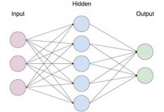
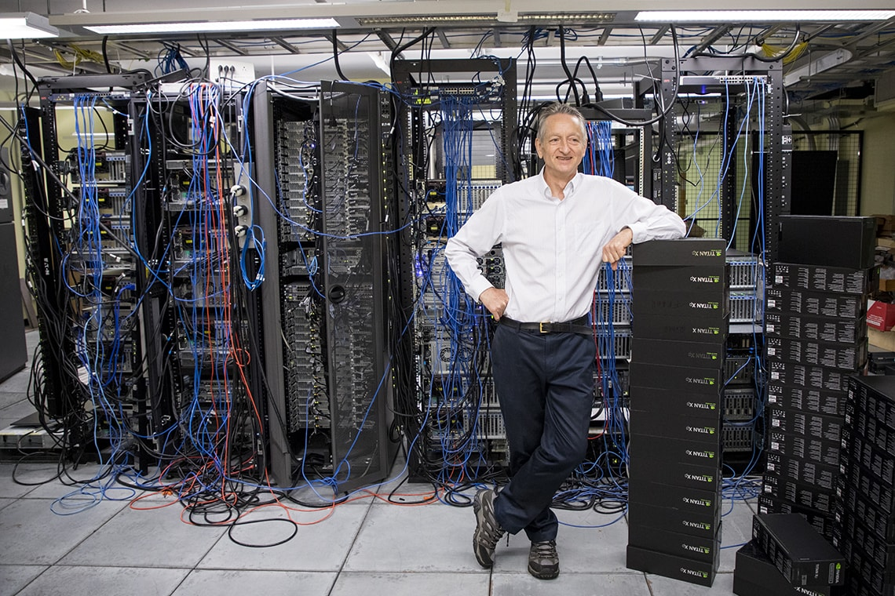
The Brief Thaw (1980-1987)
Backpropagation Algorithm and Multilayer Perceptron (MLP)
A multilayer neural network containing one hidden layer
In 1986, David Rumelhart, Geoffrey Hinton, Ronald J. Williams, and others proposed the backpropagation algorithm, which solved the training problem for multilayer neural networks.
Multilayer neural networks introduced hidden layers, breaking through the limitation of the Perceptron model which could only handle linearly separable problems, and laid the foundation for the development of modern artificial intelligence.
Geoffrey Hinton in a server room
Notes:
图片来自 Lewis的 “The Silent Reader”（1920）。

Slide 19
The Second Lull (1987-1993)
The cost of constructing and maintaining expert system knowledge bases was extremely high. Not only was it difficult to collect knowledge from experts, but updating and expanding the knowledge was also very difficult because new and old knowledge often conflicted. For example, the disease diagnosis system CADUCEUS, developed by the University of Pittsburgh, took nearly a decade just to build its knowledge base. As these problems became apparent, enthusiasm for AI was once again dampened, leading to a sharp reduction in AI investment.

Slide 20
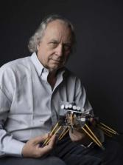
The Second Lull (1987-1993)
Rodney Brooks, in his paper "Elephants Don't Play Chess," questioned the symbolic approach. He argued that artificial intelligence research should not be limited to symbolic logic but should focus more on fundamental intelligent behaviors, such as perception, motion, and interaction with the environment.
This viewpoint later developed into the "behaviorism" school of thought, which spurred a great deal of research into biomimetic insects and opened up a new direction for artificial intelligence research.

Slide 21
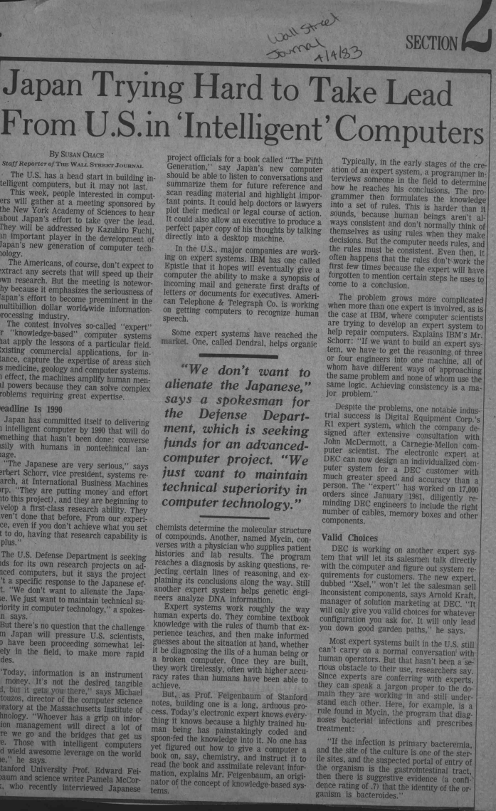
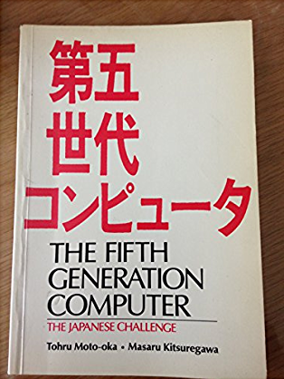
The Second Lull (1987-1993)
The setback of Japan's ambitious "Fifth Generation Computer" project, launched in 1978, also caused artificial intelligence researchers to be questioned again.
The "Fifth Generation Computer" project aimed to develop intelligent machines capable of natural communication with humans and possessing human-like reasoning abilities.
However, by the early 1990s, it was discovered that this grand goal was too far ahead of its time and might be impossible to achieve. Technically, the project still relied on logical reasoning and expert systems, whose limitations were becoming increasingly apparent. Coupled with the bursting of Japan's economic bubble, this led to the project failing to meet its expected goals.
Promotional material for Japan's Fifth Generation Computer

Slide 22
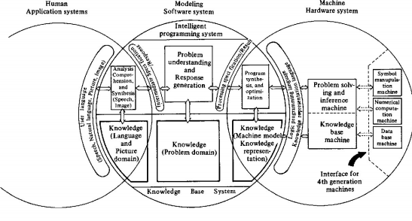
The Second Lull (1987-1993)
Similar to other AI projects, the expectations for the "Fifth Generation Computer" project were far higher than what the technology could actually achieve. Ultimately, the failure of this project also became one of the major reasons for artificial intelligence entering its second downturn.
Conceptual diagram of Japan's "Fifth Generation Computer." On the right is the hardware system, including the database, computing units, and other basic infrastructure; in the middle is the software system, including the domain knowledge system and feedback generation system; on the left is the application system, which interacts with the machine through various forms such as voice, text, and images. Image source: Moto-Oka (1983).

Slide 23
Thinking and Activities
Activity 1: Timeline Creation
Group Task:
Use cards to mark key events in AI development (1956 Dartmouth Conference, 1969 "Perceptrons", 1986 Backpropagation).
Discussion: "Which events were technological breakthroughs? Which were conceptual shifts?"

Slide 24
Thinking and Activities
Activity 2: Expert System Design Challenge
Task: Design the core rules for a "Campus Life Advisor" expert system (e.g., course selection, activity recommendations).
Discussion:
“How can vague student needs be translated into logical rules? What difficulties will be encountered?”

Slide 25
Course Summary
Early AI Development = Technological Breakthrough (Golden Decade) → Reflection and Adjustment (Winter and Thaw) → Vision Reshaping (Lessons from the Lull).
Early AI Development Trajectory: Peak → Trough → Re-exploration.

Slide 26
Homework
Write a short essay analyzing the similarities and differences between ChatGPT and ELIZA, and reflect on "whether AI truly understands language."

